Slide 1
Artificial Intelligence
Informed Search Algorithms
Notes:
Slides and exercises are inspired by Russell & Norvig AI Book, Stanford’s AI course and from Berkeley’s AI course

Slide 2
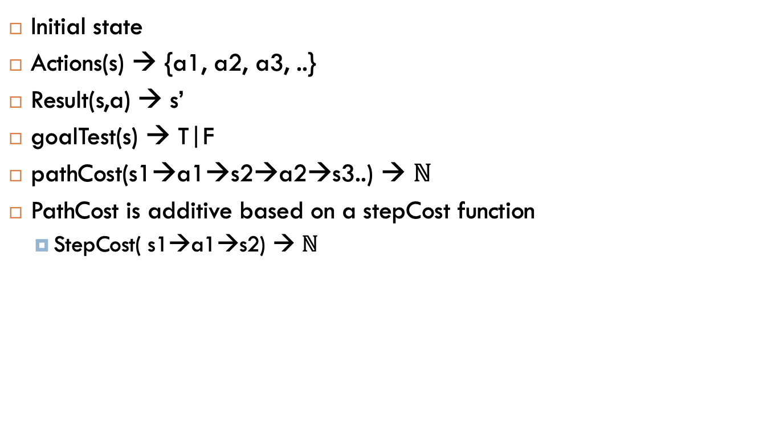
Definition of a problem
Initial state
Actions(s) → {a1, a2, a3, ..}
Result(s,a) → s’
goalTest(s) → T|F
pathCost(s1→a1→s2→a2→s3..) → $ℕ$
PathCost is additive based on a stepCost function
StepCost( s1→a1→s2) → $ℕ$

Slide 3
Search strategies
Uninformed
Informed
Breadth first search
Uniform cost search
Depth first search
Greedy best-first search
A* Search

Slide 4
Heuristic functions
A heuristic is:
A function that estimates how close a state is to a goal
Designed for a particular search problem
Example SLD: Straight Line Distance to Bucharest

Slide 5
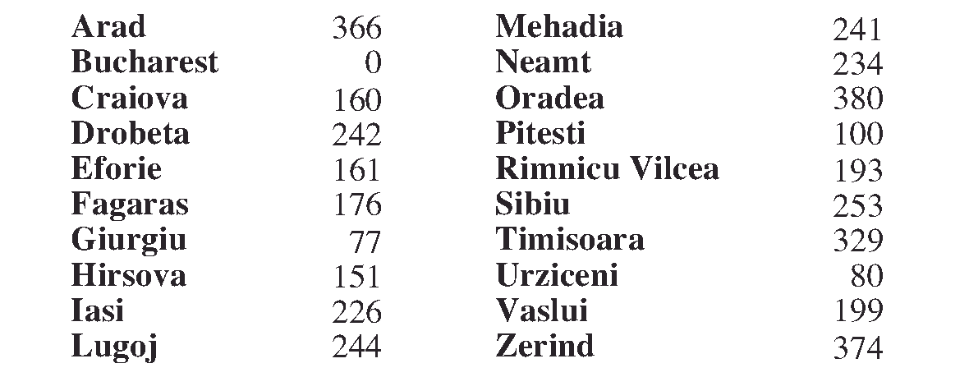
Greedy best-first search
Straight line distance to Bucharest
Greedy best-first search tries to expand the node that is closest to the goal, on the grounds that this is likely to lead to a solution quickly. Thus, it evaluates nodes by using just the heuristic function; that is, f(n)=h(n).

Slide 6
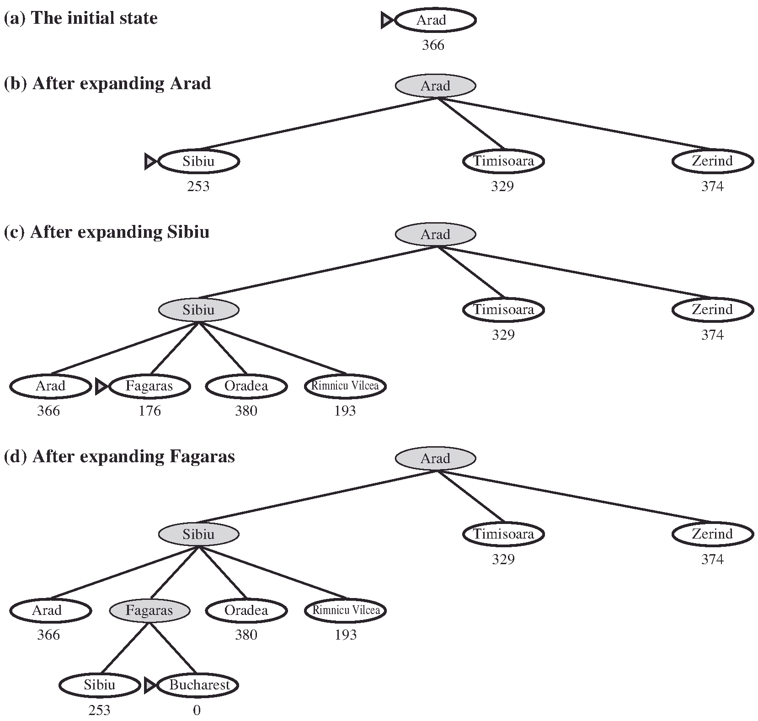
Greedy best-first search

Slide 7
Greedy search is not optimal
And it is incomplete for search trees
Example

Slide 8
A* search
Uniform-cost orders by path cost, or backward cost g(n)
Greedy orders by goal proximity, or forward cost h(n)
A* Search orders by the sum:
f(n) = g(n) + h(n)
f(n)= estimated cost of the cheapest solution through n.
A* is complete
A* is optimal if the chosen heuristic is admissible (tree version) or consistent (graph version)

Slide 9
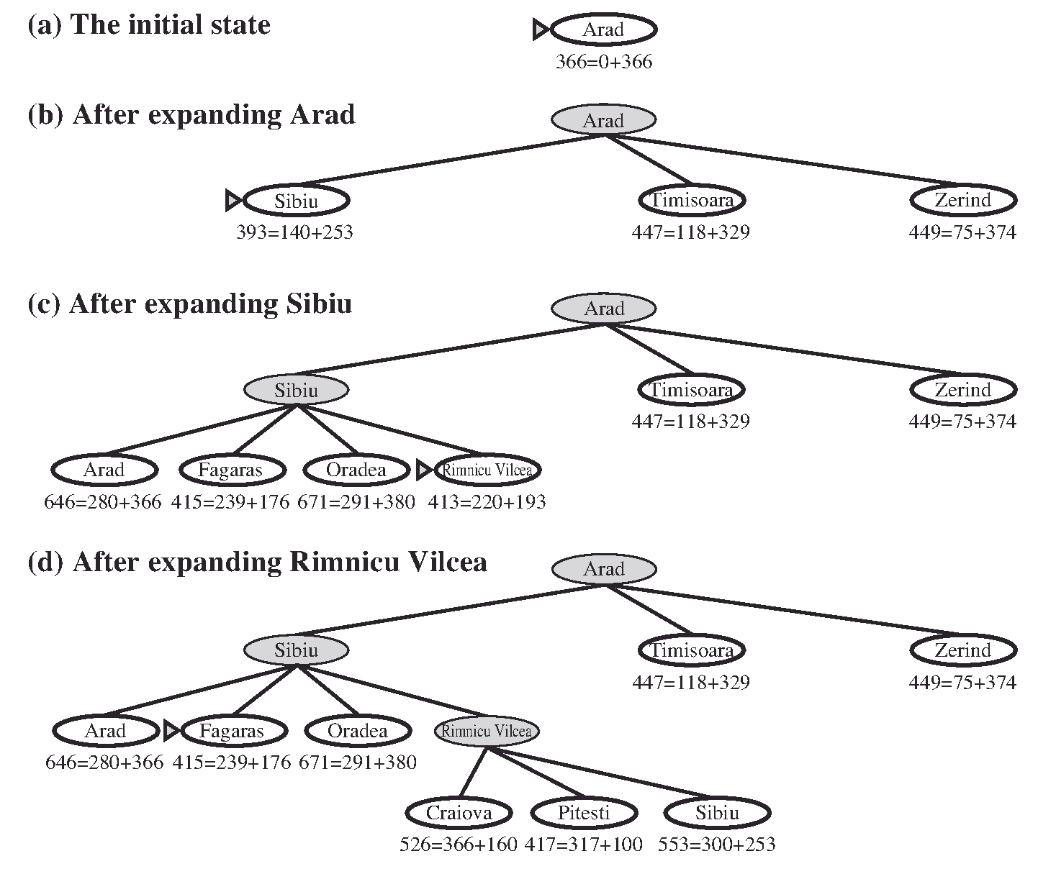
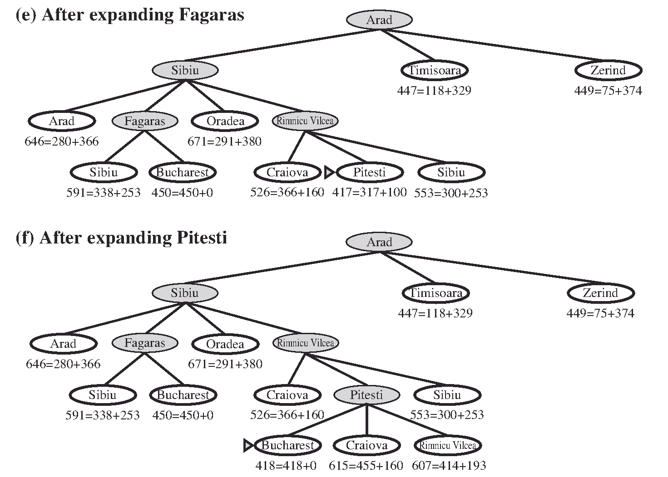
A* search
Why I don’t stop here?

Slide 10

Admissibility
Admissible heuristic is one that never overestimates the true cost to reach the goal:
$$h(n) ≤ h^{∗}(n)$$
In consequence f(n) is optimistic: it never overestimates the true cost of a solution along the current path through n.
Example:

Slide 11
Consistency
Consistency (or sometimes monotonicity) is stronger condition than admissibility and it is required for graph search.
A heuristic h(n) is consistent if, for every node n and every successor n’ of n generated by any action a, the estimated cost of reaching the goal from n is such as:
h(n)≤ c(n,a,n’) + h(n’)
This is a form of the general triangle inequality.
Consistency always means admissibility
Admissibility doesn’t imply consistency but it is hard to find heuristics that are admissible but not consistent

Slide 12
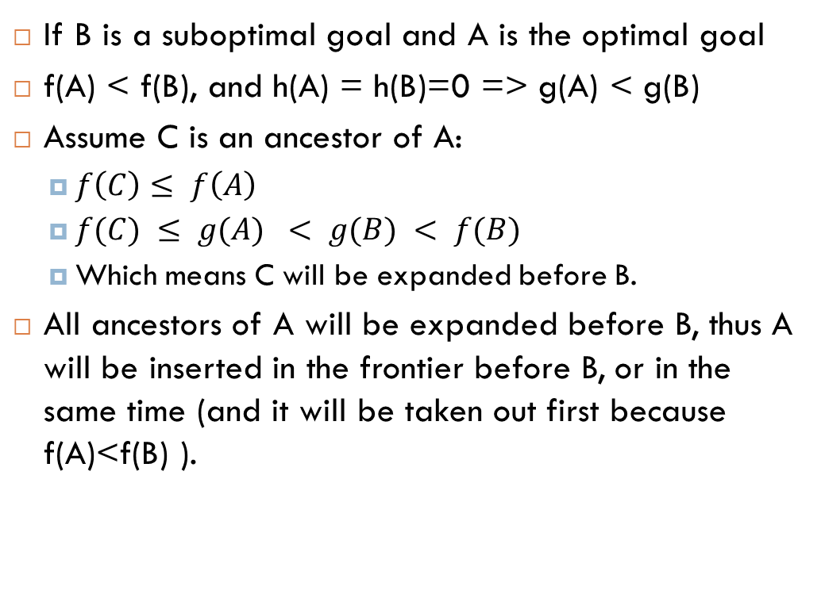
Proof of optimality for tree search
If B is a suboptimal goal and A is the optimal goal
f(A) < f(B), and h(A) = h(B)=0 => g(A) < g(B)
Assume C is an ancestor of A:
$f\left(C\right)≤ f\left(A\right)$
$f(C) ≤ g(A) < g(B) < f(B)$
Which means C will be expanded before B.
All ancestors of A will be expanded before B, thus A will be inserted in the frontier before B, or in the same time (and it will be taken out first because f(A)<f(B) ).

Slide 13
Why admissibility is not good enough for graph search ?
Triangular equality is broken for nodes A and C
C is no more in the frontier

Slide 14
Why admissibility is not good enough for graph search ?
h=3
C(2+3)
C(3+3)
Consistency: heuristic cost ≤ actual cost for each arc
h(B) – h(C) ≤ cost(B to C)

Slide 15
Proof of optimality for graph search
If h(n) is consistent, then the values of f(n) along any path are non-decreasing.
A* expand nodes in increasing f values (f-contours)
Suppose n’ is a successor of n; then:
g(n’)=g(n)+c(n, a, n’ ) for some action a
and we have:
f(n’)=g(n’)+h(n’)=g(n)+c(n, a, n’)+h(n’) ≥ g(n)+h(n)=f(n)

Slide 16
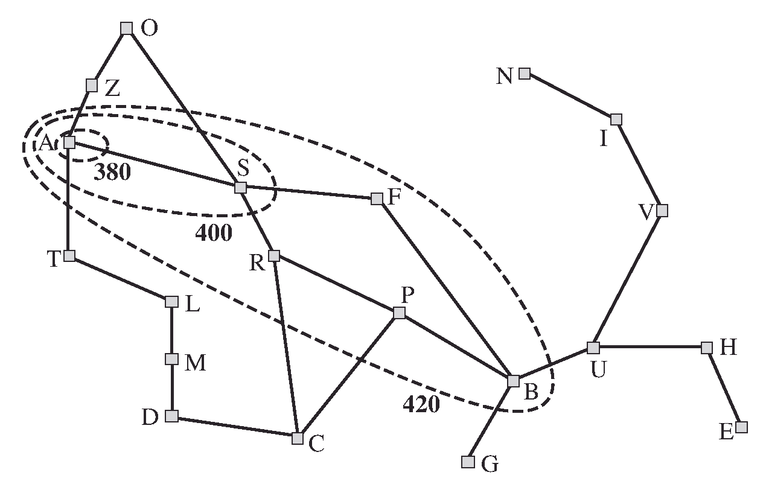
A* vs. UCS

Slide 17
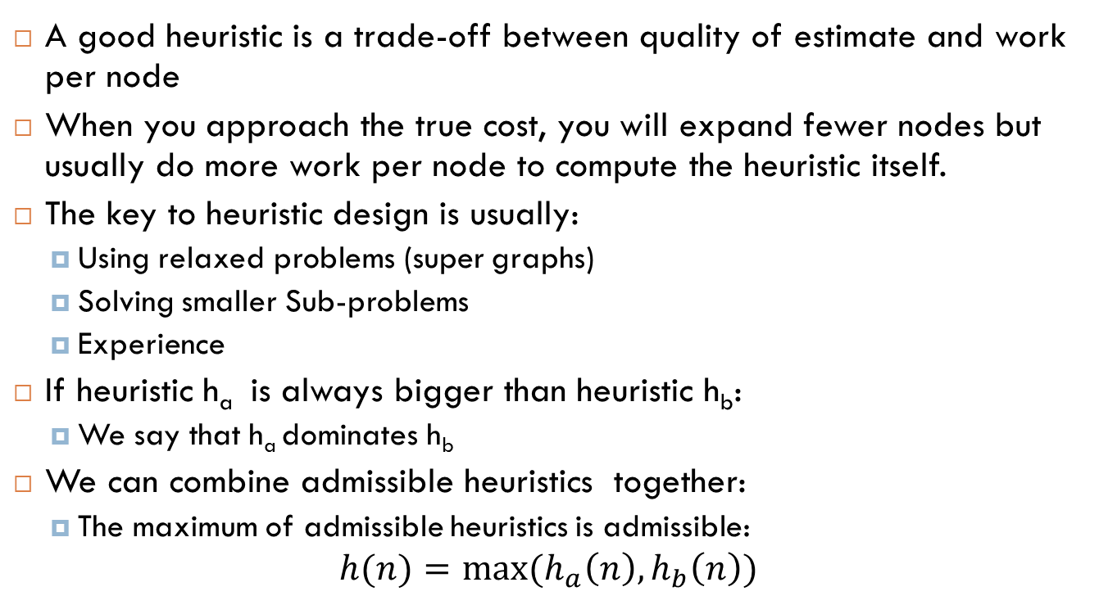
How about using the actual cost ?
A good heuristic is a trade-off between quality of estimate and work per node
When you approach the true cost, you will expand fewer nodes but usually do more work per node to compute the heuristic itself.
The key to heuristic design is usually:
Using relaxed problems (super graphs)
Solving smaller Sub-problems
Experience
If heuristic h_{a} is always bigger than heuristic h_{b}:
We say that h_{a} dominates h_{b}
We can combine admissible heuristics together:
The maximum of admissible heuristics is admissible:
$$h(n)=max⁡(h_{a}\left(n\right),h_{b}\left(n\right))$$

Slide 18
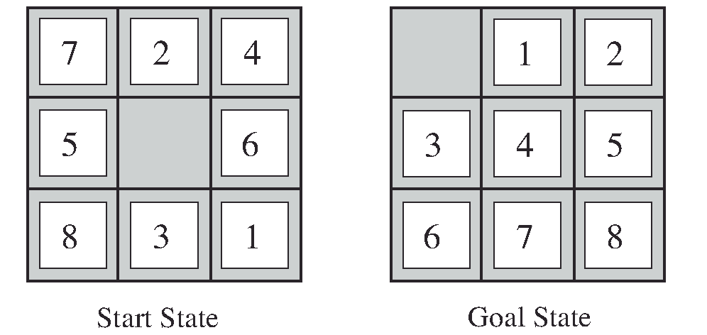
Example: 8-puzzle problem
h1 = the number of misplaced tiles. so the start state would have
h1 =8
h2 = the sum of the distances of the tiles from their goal positions. Because tiles cannot move along diagonals, the distance we will count is the sum of the horizontal and vertical distances. This is sometimes called the city block distance or Manhattan distance. Tiles 1 to 8 in the start state give a Manhattan distance of
h2 = 3+1+2+2+2+3+3+2 =18

Slide 19
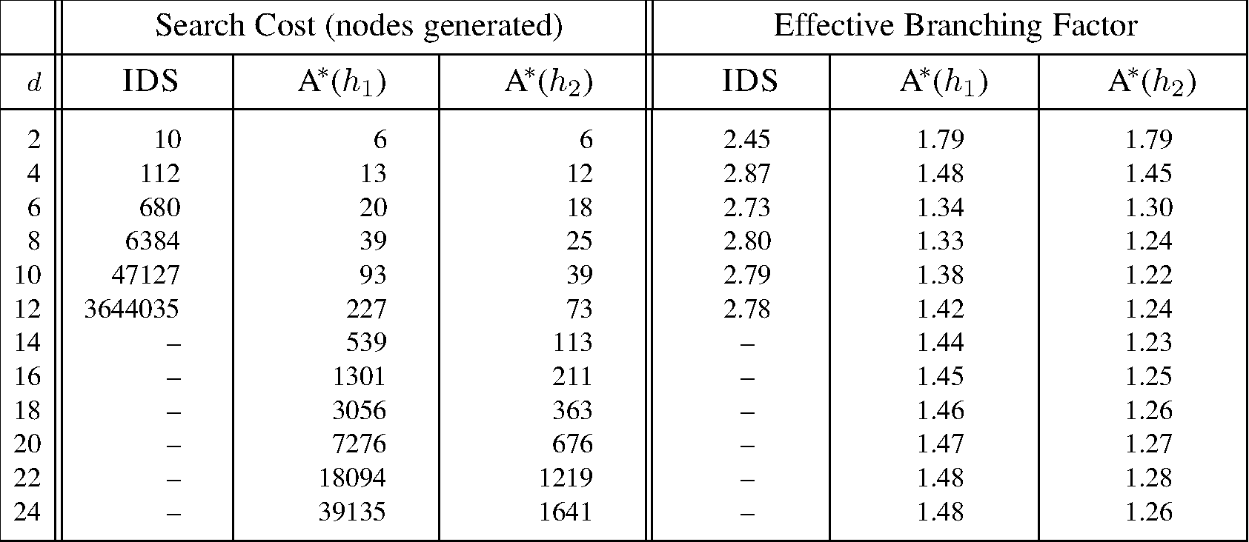
Comparison of A* (h1, h2) and Iterative Deepening Search (IDS)
One way to characterize the quality of a heuristic is the effective branching factor b∗.
If the total number of nodes generated by A∗ for a particular problem is N and the solution depth is d, then b∗ is the branching factor that a uniform tree of depth d would have to have in order to contain N +1 nodes. Thus,
N +1=1+b∗ +(b∗)² + ···+(b∗)^{d}

Slide 20
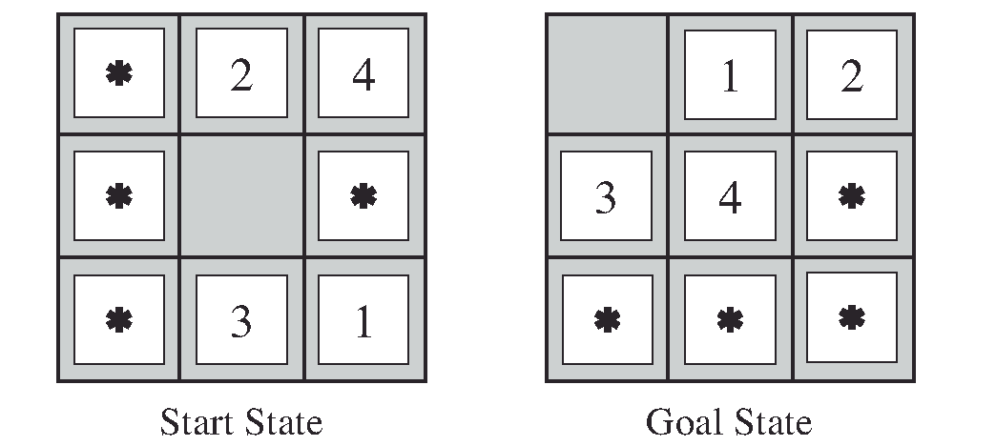
Heuristic: Solving smaller Sub-problems

Slide 21
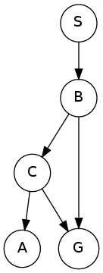
Exercises
How many nodes are in the complete search tree for the given state space graph? The start state is S.
Notes:
6

Slide 22
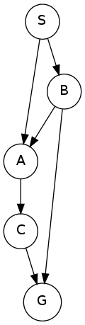
Ex 2
Consider a depth-first graph search on this graph, where S is the start and G is the goal state. Assume that ties are broken alphabetically (so a partial plan S->X->A would be expanded before S->X->B and S->A->Z would be expanded before S->B->A).
What is the final path returned by depth-first graph search?
Notes:
SACG

Slide 23
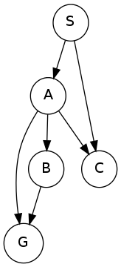
Ex 3
Consider a breadth-first graph search on this graph, where S is the start and G is the goal state. Assume that ties are broken alphabetically (so a partial plan S->X->A would be expanded before S->X->B and S->A->Z would be expanded before S->B->A).
What is the final path returned by breadth-first graph search?
Notes:
SAG

Slide 24
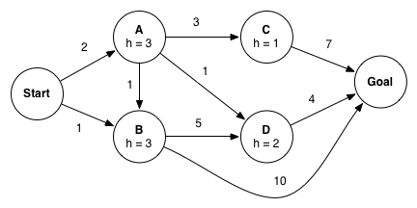
Ex4
Consider A* graph search on the graph below. Arcs are labeled with action costs and states are labeled with heuristic values. Assume that ties are broken alphabetically (so a partial plan S->X->A would be expanded before S->X->B and S->A->Z would be expanded before S->B->A).
In what order are states expanded by A* graph search?
What path does A* graph search return?
Notes:
a) Start, B, A, D, C
b) Start-A-D-Goal

Slide 25
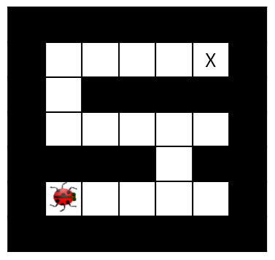
A maze
You control one or more insects in a rectangular maze-like environment with dimensions M×N , as shown in the figure below.
At each time step, an insect can move into an adjacent square if that square is currently free, or the insect may stay in its current location.
Squares may be blocked by walls, but the map is known. Optimality is always in terms of time steps; all actions have cost 1 regardless of the number of insects moving or where they move.

Slide 26
Ex 5
You control a single insect as shown in the maze below, which must reach a designated target location X, also known as the hive. There are no other insects moving around.
What is a minimal correct state space representation?
What is the size of the state space?
Give two admissible heuristics.
Notes:
A tuple (x,y) encoding the x and y coordinates of the insect.
MN
Euclidean distance, Manhattan distance

Slide 27
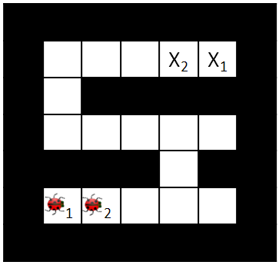
Ex 6
You control K insects, each of which has a specific target ending location X_{k}.
No two insects may occupy the same square.
In each time step all insects move simultaneously to a currently free square (or stay in place);
adjacent insects cannot swap in a single time step.
What is a minimal correct state space representation?
What is the size of the state space?
Notes:
K tuples ((x1,y1),(x2,y2),…,(xK,yK)) encoding the x and y coordinates of each insect.
(MN)^K
As you have suggested in the class, taking the constraint into account is more precise and leads to: (MN)!/(MN-K)!

Slide 28
Ex 6 - continue
Which of the following heuristics are admissible (if any)?
Sum of Manhattan distances from each insect's location to its target location.
Sum of costs of optimal paths for each insect to its goal if it were acting alone in the environment, unobstructed by the other insects.
Max of Manhattan distances from each insect's location to its target location.
Max of costs of optimal paths for each insect to its goal if it were acting alone in the environment, unobstructed by the other insects.
Number of insects that have not yet reached their target location.
Notes:
3 & 4

Slide 29
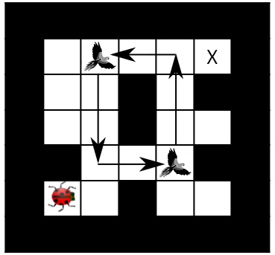
Ex 7
You again control a single insect, but there are B birds flying along known paths. Specifically, at time t each bird b will be at position (x_{b}(t),y_{b}(t)). The tuple of bird positions repeats with period T.
Birds might move up to 3 squares per time step.
Your insect can share squares with birds and it can even hitch a ride on them! On any time step that your insect shares a square with a bird, the insect may either move as normal or move directly to the bird’s next location (either action has cost 1, even if the bird travels farther than one square).
What is a minimal state representation?
What is the size of the state space?
Notes:
A tuple (x,y) giving the position of the insect, plus an integer r=t mod T where t is the time step.
MNT

Slide 30
Ex 7 – continue
Which of the following heuristics are admissible (if any)?
Cost of optimal path to target in the simpler problem that has no birds.
Manhattan distance from the insect's current position to the target.
Manhattan distance from the insect's current position to the nearest bird.
Manhattan distance from the insect's current position to the target divided by three.
Notes:
Nb 4 only

Slide 31
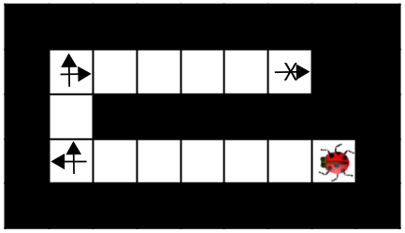
Ex 8
Your single insect is alone in the maze again. This time, it has super legs that can take it as far as you want in a straight line in each time step. The disadvantage of these legs is that they make turning slower, so now it takes the insect a time step to change the direction it is facing.
Moving v squares requires that all intermediate squares passed through, as well as the v^{th} square, currently be empty.
The cost of a multi-square move is still 1 time unit, as is a turning move.
Give a minimal state representation
What is the size of the state space?
Example: cost = 5
Notes:
A tuple (x,y) giving the position of the insect, plus the direction the insect is facing.
4 MN

Slide 32
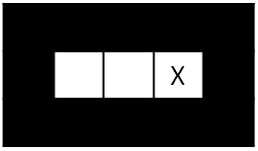
Ex 9
It is night and you control a single insect. You know the maze, but you do not know what square the insect will start in. You must pose a search problem whose solution is an all-purpose sequence of actions such that, after executing those actions, the insect will be on the exit square, regardless of initial position.
The insect executes the actions mindlessly and does not know whether its moves succeed: if it uses an action which would move it in a blocked direction, it will stay where it is.
Give a state representation
What is the size of state space?
For example, in the maze above, moving right twice guarantees that the insect will be at the exit regardless of its starting position.
Notes:
A list of boolean variables, one for each position in the maze, indicating whether the insect could be in that position. 2^{MN}

Slide 33
Ex 9 – continue
Which of the following are admissible heuristics?
Total number of possible locations the insect might be in.
The maximum of Manhattan distances to the goal from each possible location the insect could be in.
The minimum of Manhattan distances to the goal from each possible location the insect could be in.
Notes:
2 and 3
The first is wrong. Take the previous example, we need only 2 moves whereas the insect can be in one of the 3 positions at the start.

Slide 34
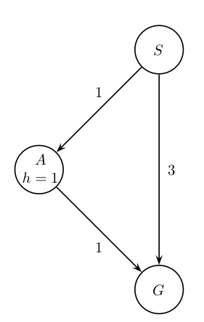
Ex 10 - Early goal checking graph search
If using EARLY-GOAL-CHECKING-GRAPH-SEARCH which path, if any, will the algorithm return?
with a Uniform Cost node expansion strategy?
with an A* node expansion strategy?
Which statements are true:
The EXPAND function can be called at most once for each state.
The algorithm is complete.
The algorithm will return an optimal solution.
Notes:
SG
SG
1 and 2 but not 3

Slide 35
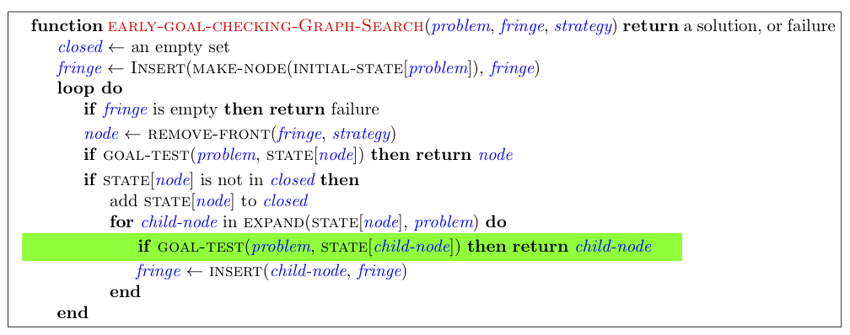

Slide 36
Ex 11 – look ahead graph search
Consider an alternative version of GRAPH-SEARCH, LOOKAHEAD-GRAPH-SEARCH, which saves memory by using a "frontier-closed-set" keeping track of which states have been on the frontier and only adding a child node to the frontier if the state of that child node has not been added to it at some point.
With an A* node expansion strategy, which path will this algorithm return?
Notes:
SBG

Slide 37
Ex 11 – continue
Assume you run LOOKAHEAD-GRAPH-SEARCH with the A* node expansion strategy and a consistent heuristic, select all statements that are true.
The EXPAND function can be called at most once for each state.
The algorithm is complete.
The algorithm will return an optimal solution.
Notes:
1 and 2

Slide 38
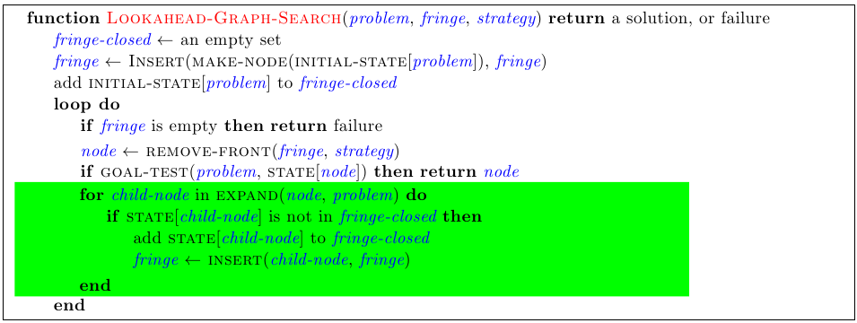

Slide 39
Ex 12 - memory-efficient graph search
Consider an alternate version of GRAPH-SEARCH, MEMORY-EFFICIENT-GRAPH-SEARCH, which saves memory by
(a) not adding node n to the fringe if STATE[n] is in the closed set,
and (b) checking if there is already a node in the fringe with state equal to STATE[n]. If so, rather than simply inserting, it checks whether the old node or the new node has the cheaper path and then accordingly leaves the fringe unchanged or replaces the old node by the new node.
By doing this the fringe needs less memory, however insertion becomes more computationally expensive.
with the A* node expansion strategy and a consistent heuristic, select all statements that are true.
The EXPAND function can be called at most once for each state.
The algorithm is complete.
The algorithm will return an optimal solution.
Notes:
1, 2, 3 are true

Slide 40
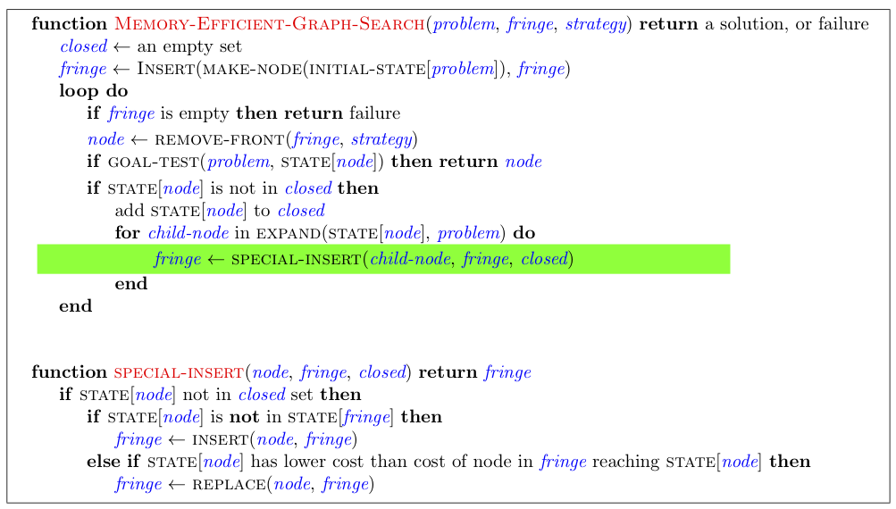

Slide 41
